Slide 1
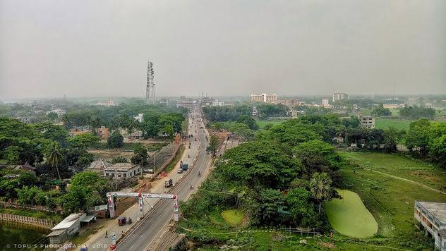
Presentation on
DISTRICT INTRODUCTION
MANIKGANJ

Slide 2
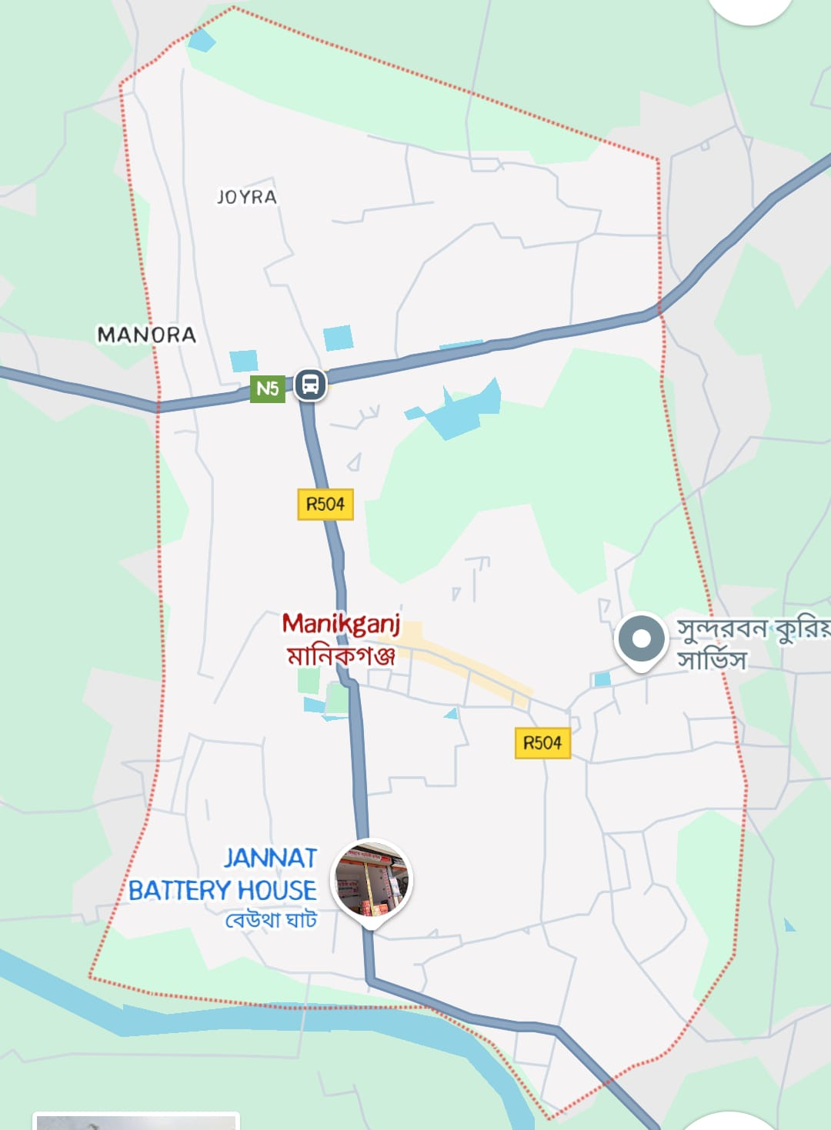
Manikgonj District Map
Manikganj is a district in central Bangladesh, situated along the banks of the Jamuna, Padma, and Dhaleshwari rivers. Known for its natural beauty and historical significance, it boasts attractions like Baliati Zamindar Bari and Teota Rajbari.

Slide 3
Manikgonj District Upozila And Union
Manikganj district has a total of 7 upazilas and 65 unions.
UpazilasThe 7 upazilas are:
Manikganj Sadar
Singair
Saturia
Shibalaya
Harirampur
Ghior
Daulatpur

Slide 4
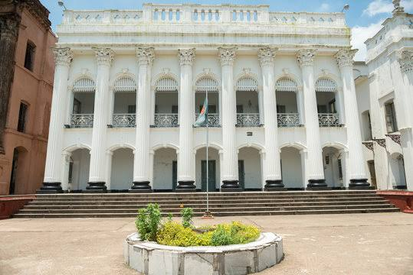
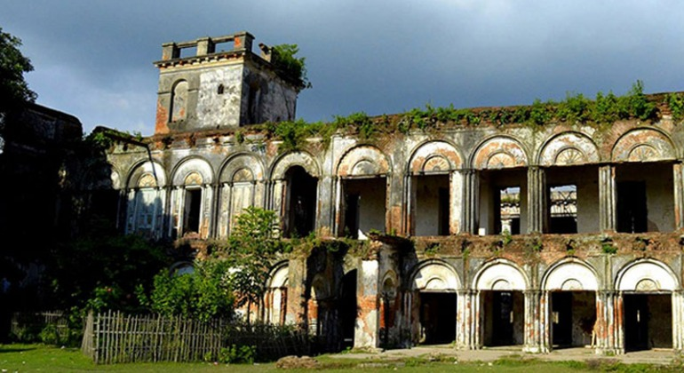
Tourist place
Baliati Zamindar Bari
Baliati Palace is located in Baliati village of Saturia Upazila, approximately eight kilometers west of Manikganj district headquarters and thirty-five kilometers from Dhaka district headquarters under Dhaka division of Bangladesh. It is one of the palaces built in the 19th century in Bangladesh. It is also called Baliati Zamindar Bari or Baliati Palace.
Teota Zamindar Bari is an ancient zamindar house and archaeological site of Bangladesh located in Shibaloy Upazila of Manikganj district. It is located in Teota village of Shivaloy Upazila
Teota Zamindar Bari

Slide 5
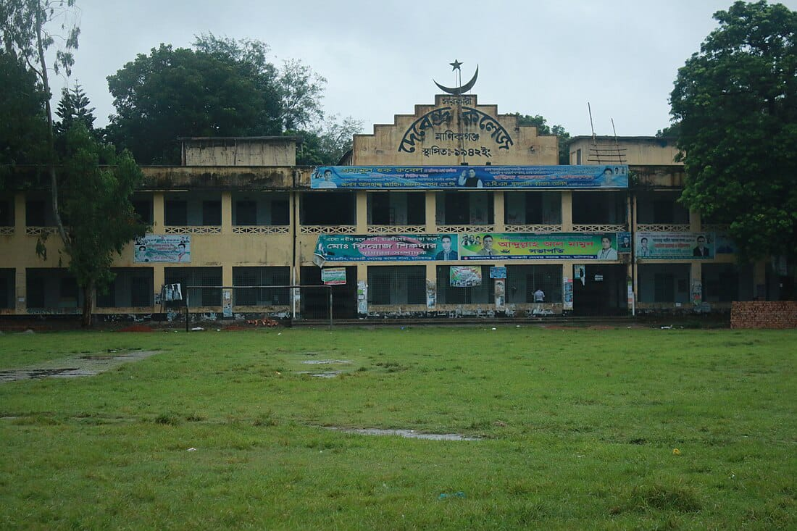
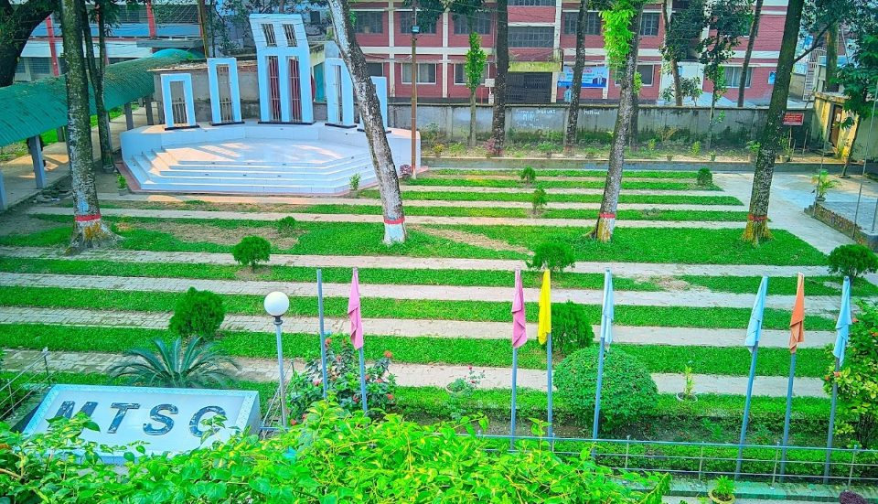
Famous Institution
Government Debendra College is a public college in Manikganj, Manikganj District, Dhaka Division, Bangladesh. It offers bachelor's degrees and master's degrees. It also has a Higher Secondary Certificate (HSC) program. It is affiliated with Bangladesh National University. As of 2015, the principal is Syed Ikbal Moiz and the vice principal is Sirajul Islam.
Government Technical School and College is a government technical education institution in Bangladesh. It is located at Sadar Police Station of Manikganj District of Dhaka Division and is under Bangladesh Technical Education Board.

Slide 6
THANK YOU

